Slide 1
Cross/multi-lingual NLP
Presenter: Xu Ma
Date: Mar/6/2019

Slide 2

Why we need Cross/multi-lingual NLP?
Most languages are Low-Resource.
What can Cross/multi-lingual NLP do?
Improve our performance beyond unsupervised learning.

Slide 3
Cross/multi-lingual NLP
Multi-Source Transfer of Delexicalized Dependency Parsers
Cross-lingual Word Clusters for Direct Transfer of Linguistic Structure
Treebank Translation for Cross-Lingual Parser Induction

Slide 4
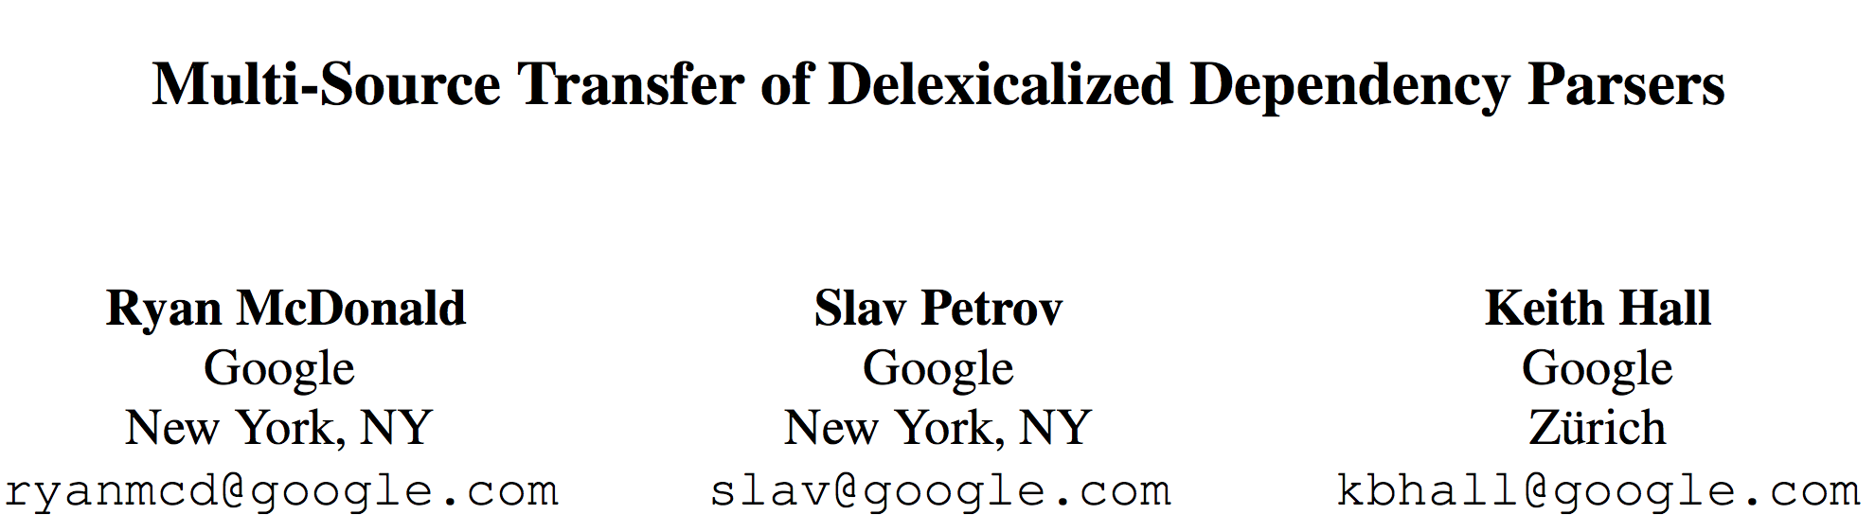

Slide 5

What is Delexicalized Dependency?
Lexicalized
Dependency
Delexicalized
Dependency
The chicken was very dry
DT NOUN VERB ADV ADJ

Slide 6
Multi-Source Transfer of Delexicalized Dependency Parsers
Contribution:
delexicalized parsers can be directly transferred between languages, producing significantly higher accuracies than unsupervised parsers.

Slide 7
Multi-Source Transfer of Delexicalized Dependency Parsers
Background
Statistical parsing:
Phrase-structure parsing(Collins, 1997; Charniak, 2000; Petrov et al., 2006)
dependency parsing(McDonald et al., 2005; Nivre et al., 2006)
Trend:
constructing parsers for new domains and new languages

Slide 8
Multi-Source Transfer of Delexicalized Dependency Parsers
Problem:
Build statistical parser for new languages:
often lack the manually annotated resources available for English
In this paper:
directly transfer delexicalized models
Traditional solution:
Grammar induction system (unsupervised learning)

Slide 9
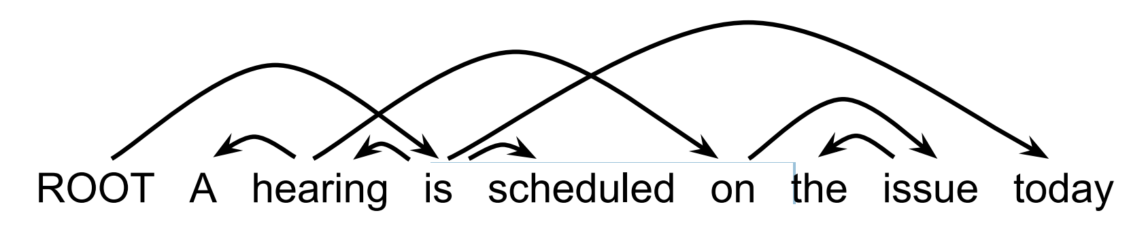
Multi-Source Transfer of Delexicalized Dependency Parsers
An example (unlabeled) dependency tree

Slide 10
Multi-Source Transfer of Delexicalized Dependency Parsers
treebank Dataset:
Output(Prediction):
NOUN (nouns)
VERB (verbs)
ADJ (adjectives)
ADV (adverbs)
PRON (pronouns)
DET (determiners)
ADP (prepositions or postpositions)
NUM (numerals)
CONJ (conjunctions)
PRT (particles)
PUNC (punctuation marks)
X (a catch-all tag)
from the CoNLL shared-tasks on dependency parsing
English as a source language (en)
Eight languages as both source and target languages
Danish (da)
Dutch (nl)
German (de)
Greek (el)
Italian (it)
Portuguese (pt)
Spanish (es)
Swedish (sv)

Slide 11
Multi-Source Transfer of Delexicalized Dependency Parsers
Evaluation:
unlabeled attachment score (UAS):
gold-standard part-of-speech tags + predicted part-of speech tags:
When no target language resources are available

Slide 12
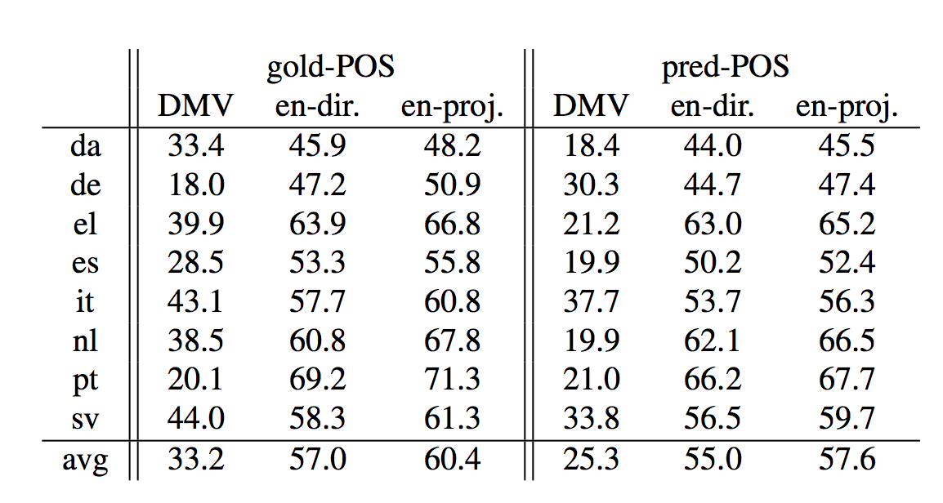
Multi-Source Transfer of Delexicalized Dependency Parsers
Transferring from English
Direct
Transfer
UAS for the dependency model with valence DMV, a delexicalized English direct transfer parser (en-dir.) and a English projected parser (en-proj.). Measured on all sentence lengths for both gold and predicted part-of speech tags as input.

Slide 13
Multi-Source Transfer of Delexicalized Dependency Parsers
Transferring from English
Direct Transfer
Why Direct Transfer is better than dependency model with valence (DMV)?
1. part-of-speech tags contain a significant amount of information for parsing unlabeled dependencies
2. This information can be transferred across languages and treebank standards.

Slide 14
Multi-Source Transfer of Delexicalized Dependency Parsers
Transferring from English
Projected Transfer
Dependency Prob
V → N 0.8
N → ADJ 0.7
DET ADJ N V
Predict
Alignment
DET N ADJ V
Projection Transfer

Slide 15
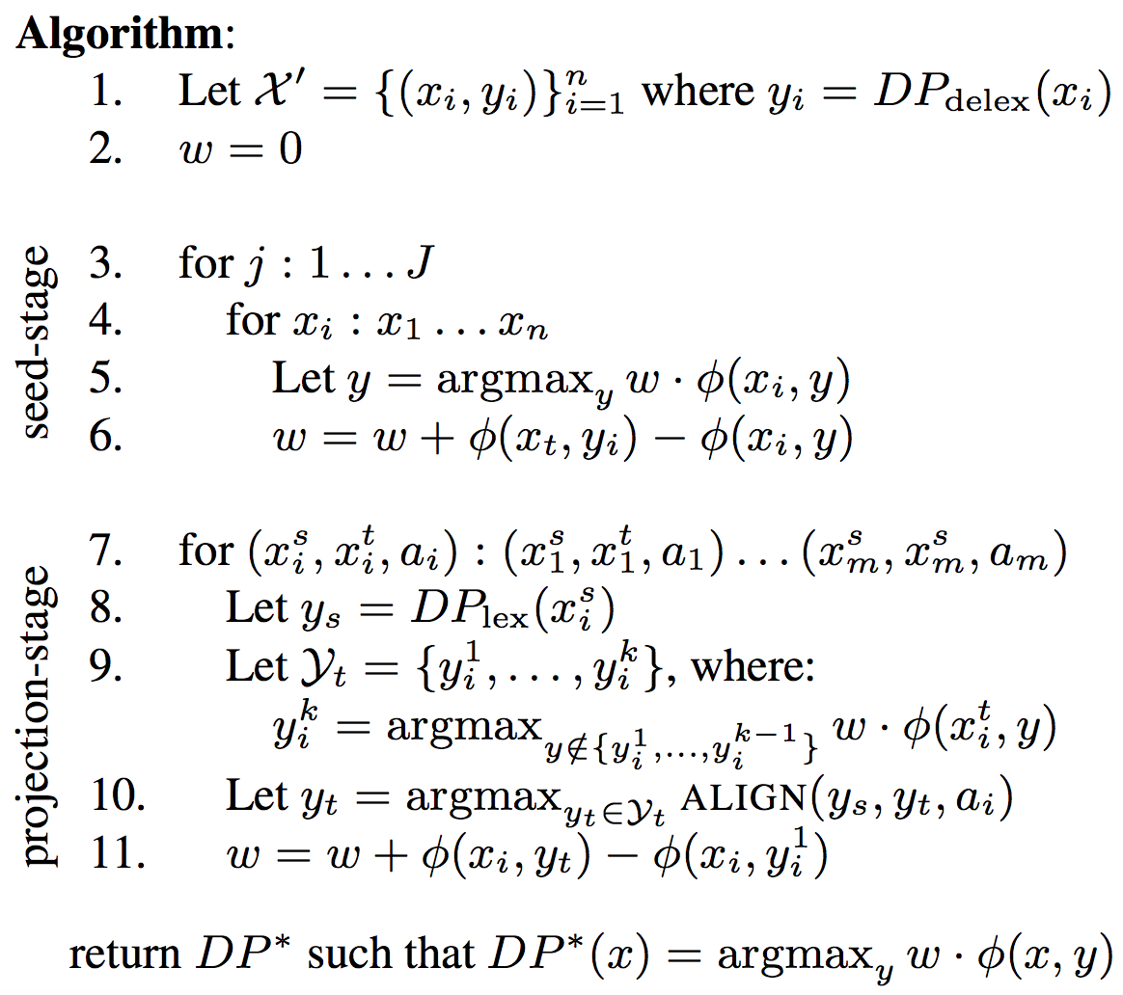
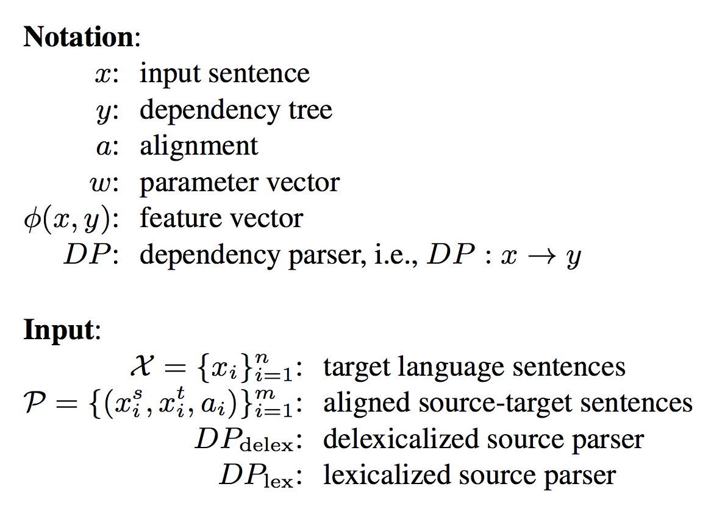
Multi-Source Transfer of Delexicalized Dependency Parsers
Transferring from English
Projected Transfer

Slide 16
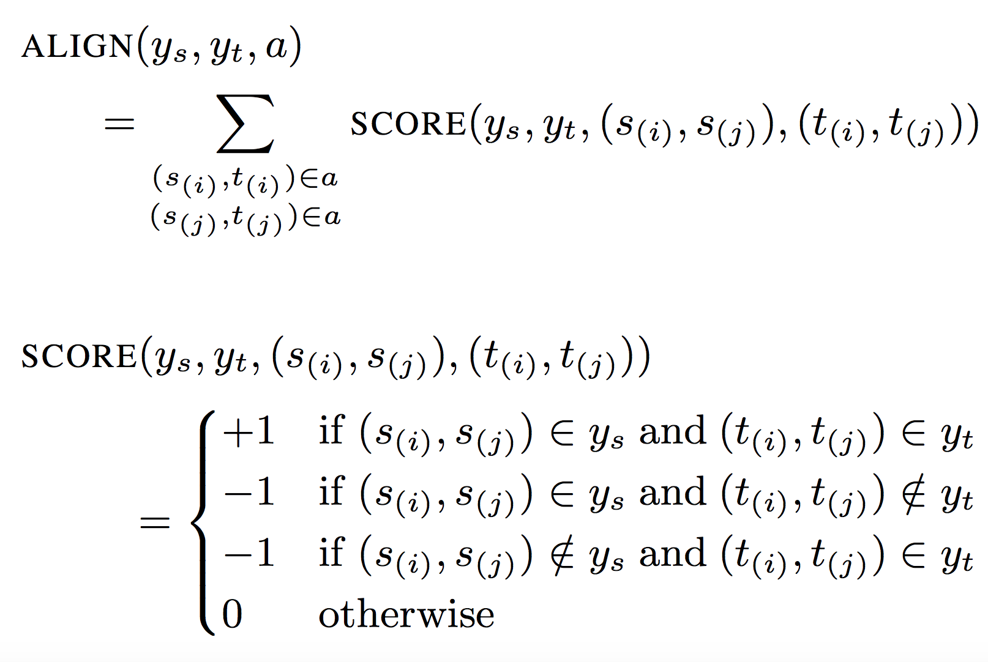
Multi-Source Transfer of Delexicalized Dependency Parsers
Transferring from English
Projected Transfer

Slide 17
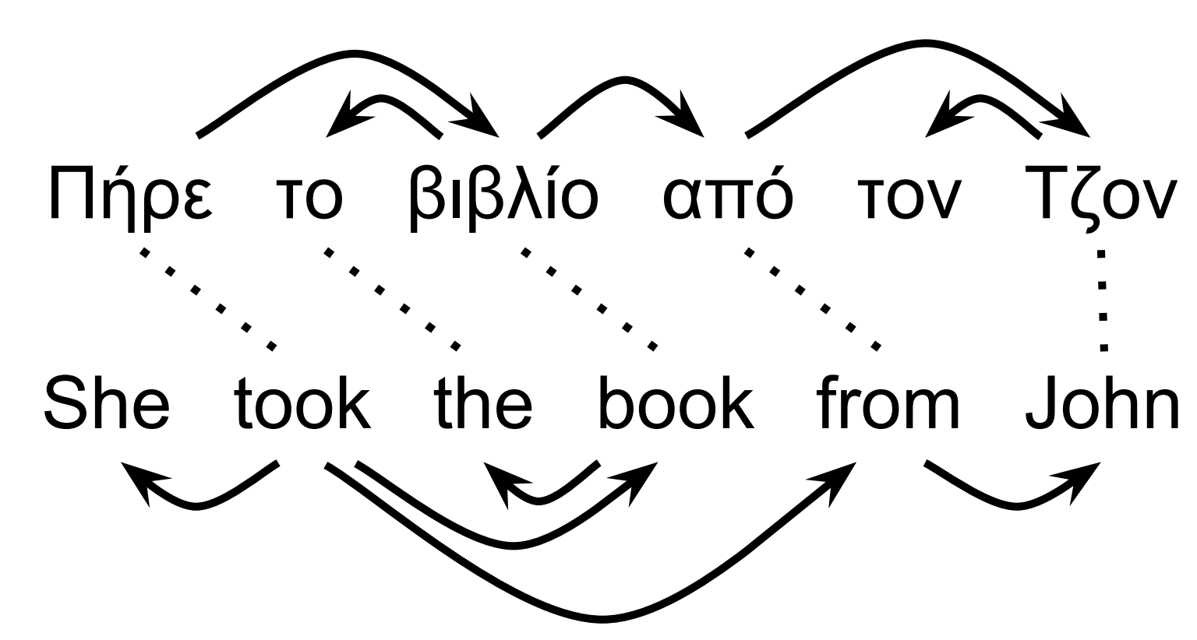
Multi-Source Transfer of Delexicalized Dependency Parsers
Transferring from English
Projected Transfer
an example of aligned English-Greek sentences
A Greek and English sentence pair. Word alignments are shown as dashed lines, dependency arcs as solid lines.

Slide 18
Multi-Source Transfer of Delexicalized Dependency Parsers
Transferring from English
Projected Transfer
UAS for the dependency model with valence DMV, a delexicalized English direct transfer parser (en-dir.) and a English projected parser (en-proj.). Measured on all sentence lengths for both gold and predicted part-of speech tags as input.

Slide 19
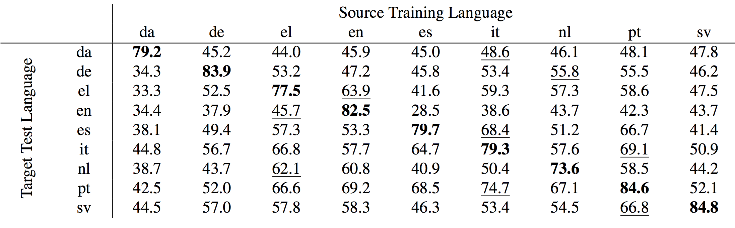
Multi-Source Transfer of Delexicalized Dependency Parsers
Transferring from English
Multi-Source Transfer
(1,6)
(2,7)
(3,4)
(4,3)
(5,6)
(6,8)
(7,3)
(8,6)
(9,8)
Blod: source = target
Underlined: best UAS for a target language
This is almost certainly due to different annotation schemes across treebanks

Slide 20
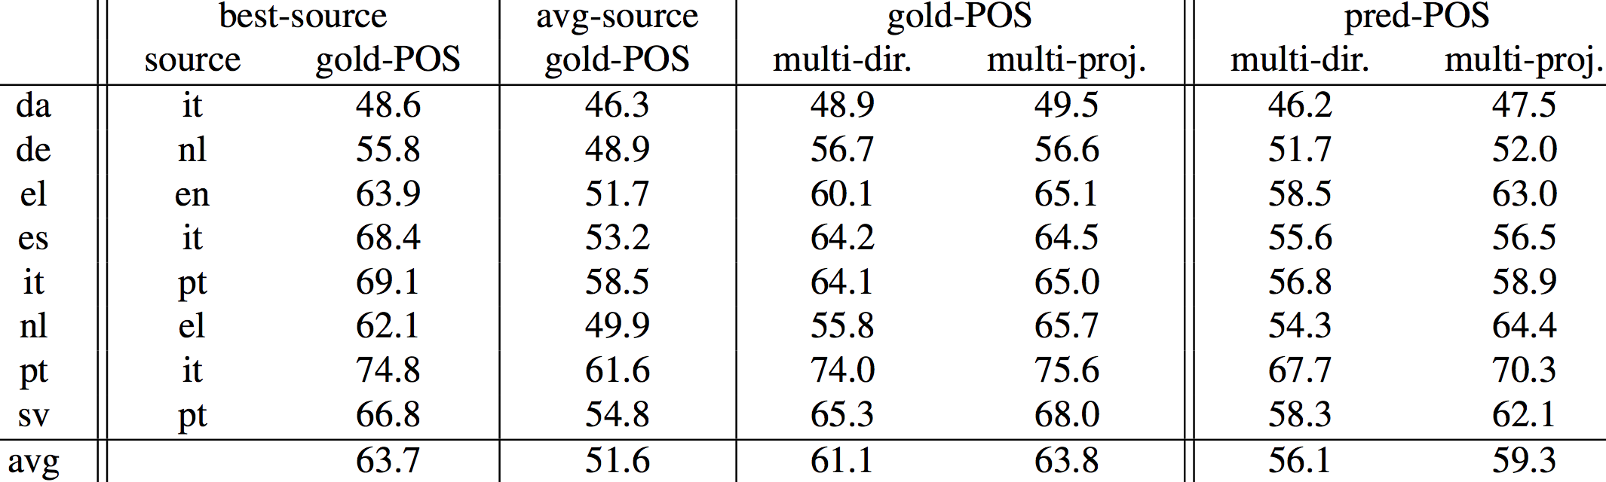
Multi-Source Transfer of Delexicalized Dependency Parsers
Transferring from English
Multi-Source Transfer
single-best
mean over all source languages
multi-source direct transfer system
multi-source projected system

Slide 21
Multi-Source Transfer of Delexicalized Dependency Parsers
Comparison
Comparing unsupervised and parser projection systems
USR: universal syntactic rules (USR+)
PGI : phylogenetic grammar induction
PR : posterior regularization

Slide 22
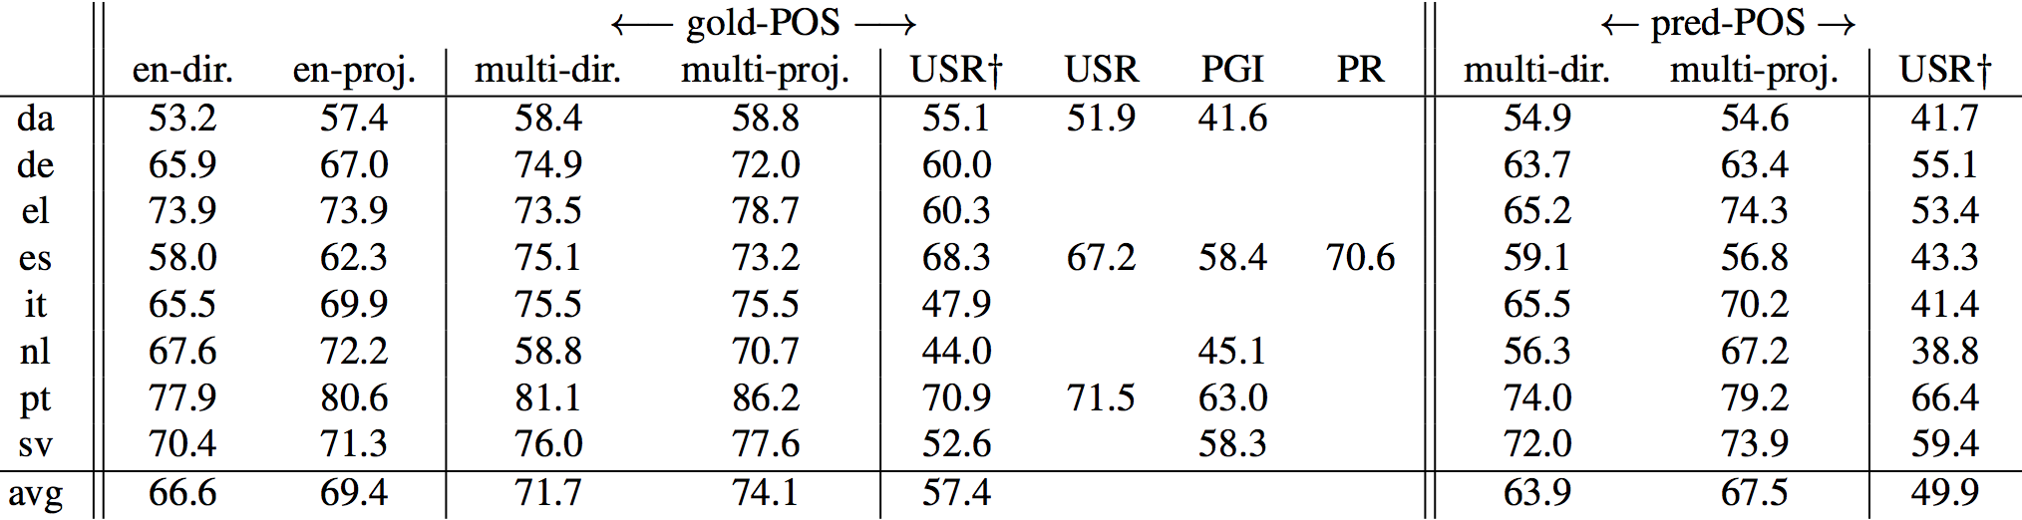
Multi-Source Transfer of Delexicalized Dependency Parsers
Comparison
multisource systems (both direct and projected) significantly outperform the unsupervised models.

Slide 23
Multi-Source Transfer of Delexicalized Dependency Parsers
Discussion
Even for languages for which no resources exist, simple methods for transferring parsers work remarkably well.
When source available, multiple sources should be used.
Conclusion
1. Present a projecting parsers from languages with labeled training data to languages without any labeled training data.
2. Experiments demonstrated that this approach outperforms related work.

Slide 24
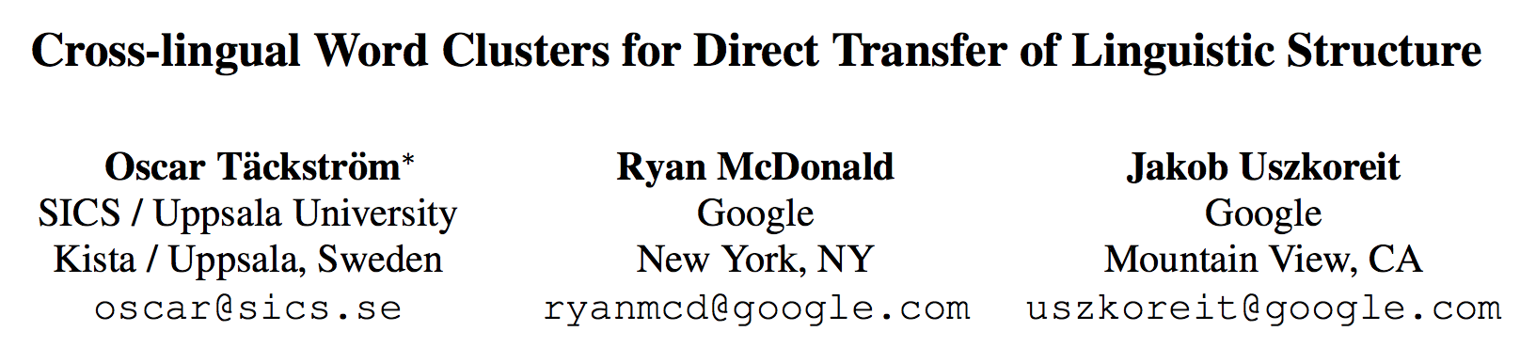
Cross-lingual Word Clusters for Direct Transfer of Linguistic Structure

Slide 25
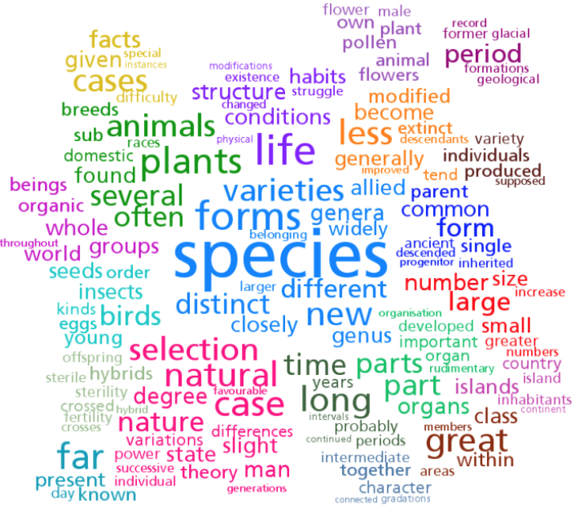
Cross-lingual Word Clusters for Direct Transfer of Linguistic Structure
What is word cluster?
Cluster 152
Cluster 61
Cluster 274
Cluster 333

Slide 26
Cross-lingual Word Clusters for Direct Transfer of Linguistic Structure
word cluster improve prediction of linguistic structure
these results hold true for a number of languages across families
other
languages
English
provide an algorithm for inducing cross-lingual clusters

Slide 27
Cross-lingual Word Clusters for Direct Transfer of Linguistic Structure
Background
1. Predict the linguistic structure of sentences or documents Not all resources has labels.
2. Unsupervised learning:
Performance not good.
Solution:
semi-supervised and linguistic-transfer methods for multilingual structure prediction
word cluster features:
Monolingual word cluster features for semi-supervised learning (SSL)
Cross-lingual word cluster features for transferring linguistic structure from English to other languages

Slide 28
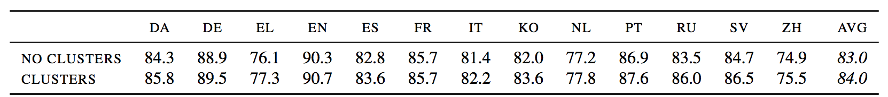
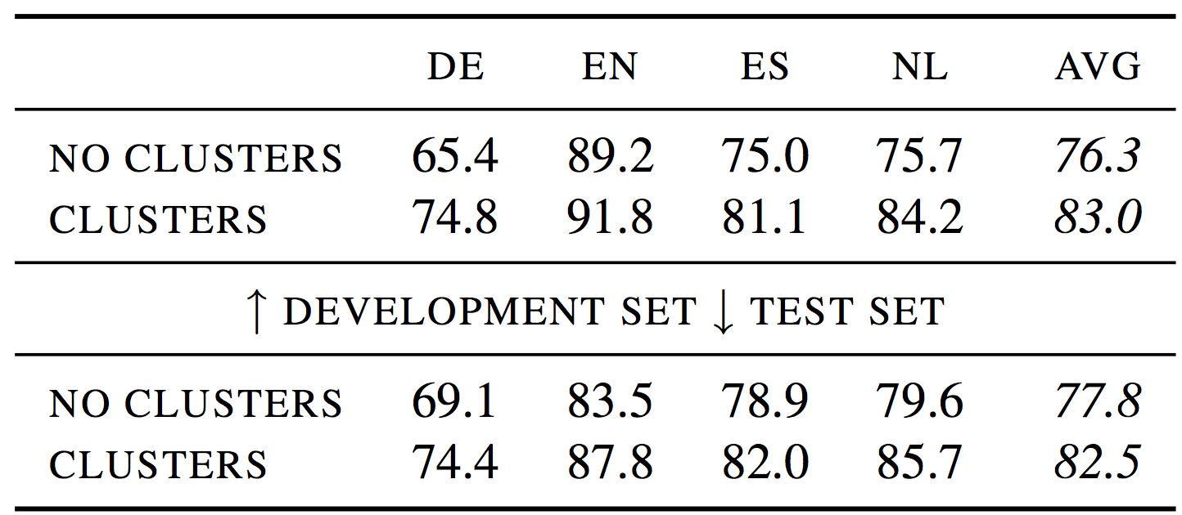
Cross-lingual Word Clusters for Direct Transfer of Linguistic Structure
How important cluster is ?
Supervised parsing results measured with labeled attachment score (LAS) on the test set
Supervised NER(named entity recognition) results measured with F1-score on the CoNLL 2002/2003 development and test sets.

Slide 29
Cross-lingual Word Clusters for Direct Transfer of Linguistic Structure
How important Cross-lingual Word Cluster Features is?
In this paper:
Propose Cross-lingual Word Cluster based on delexicalized direct transfer method (paper 1)

Slide 30
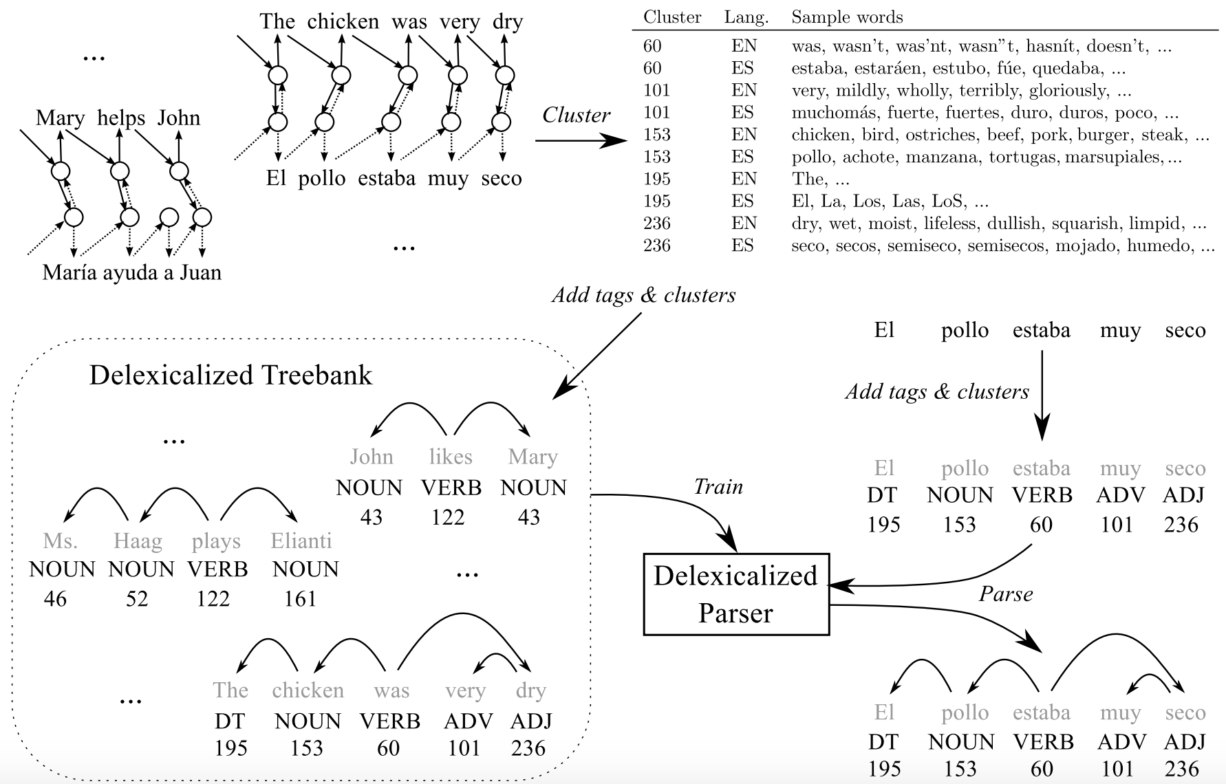
Cross-lingual Word Clusters for Direct Transfer of Linguistic Structure
Cross-lingual Word cluster
(Eg. prepositions from both languages should be in the same cluster)

Slide 31
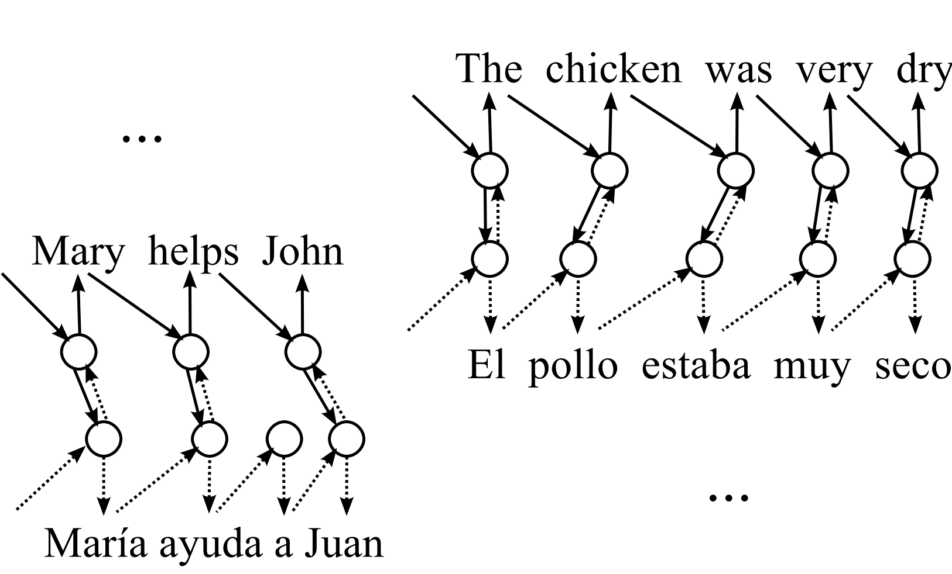
Cross-lingual Word Clusters for Direct Transfer of Linguistic Structure
1. Cross-lingual (EN-ES) word clustering model

Slide 32
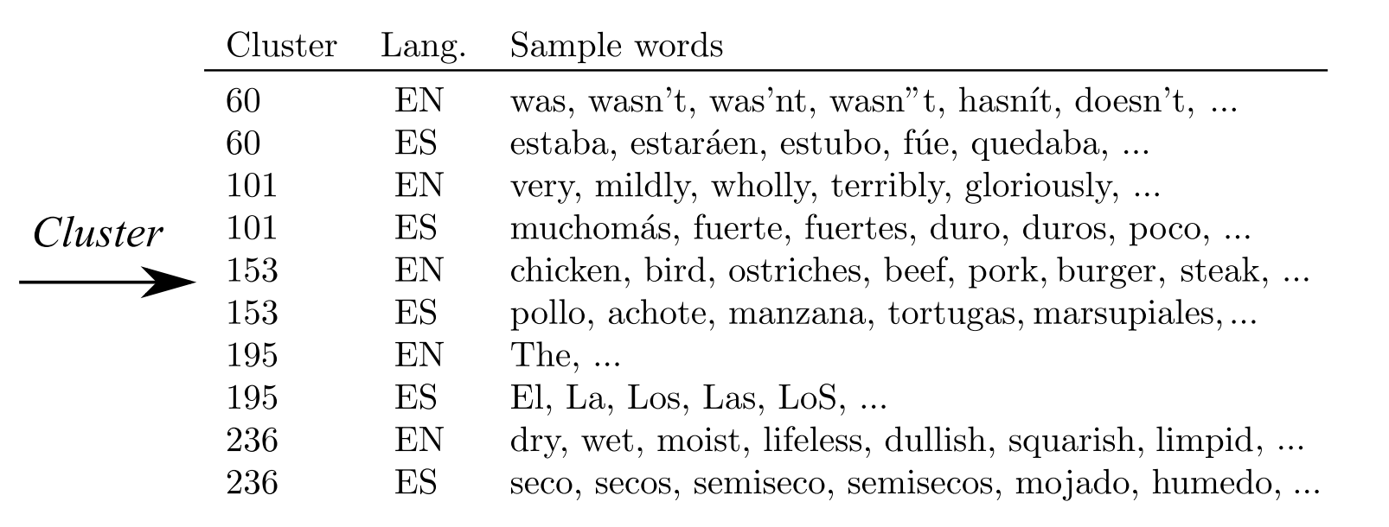
Cross-lingual Word Clusters for Direct Transfer of Linguistic Structure
2. Samples of some of the induced cross-lingual word clusters

Slide 33
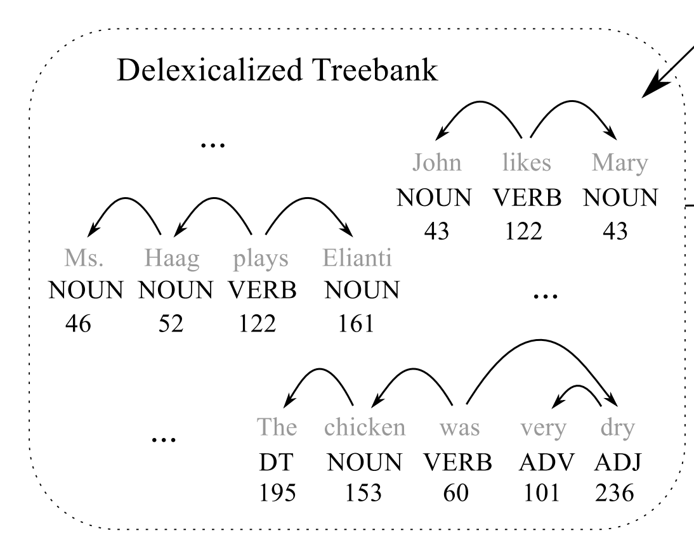
Cross-lingual Word Clusters for Direct Transfer of Linguistic Structure
Add tags and clusters
3. Delexicalized cluster-augmented source (EN) treebank for training transfer parser

Slide 34
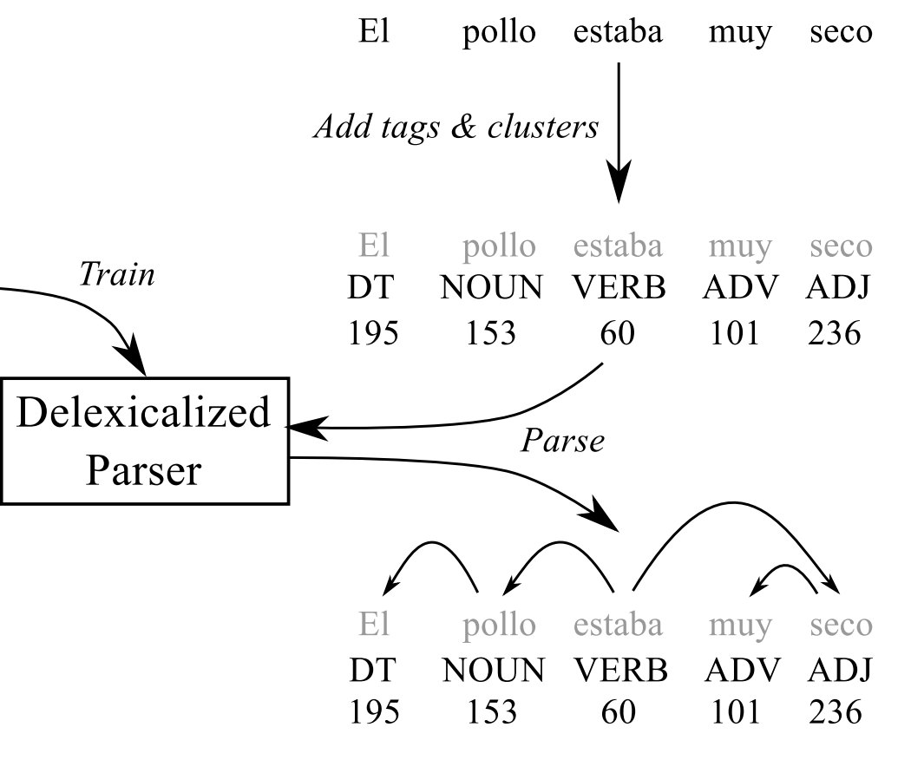
Cross-lingual Word Clusters for Direct Transfer of Linguistic Structure
4. Parsing of target (ES) sentence using the transfer parser

Slide 35
Cross-lingual Word Clusters for Direct Transfer of Linguistic Structure
Inducing Cross-lingual Word Clusters
First idea:
clusters source language (S) as in the monolingual case
projects these clusters to a target language (T) (using word alignments).
Drawbacks:
1. it only provides a clustering of those target language words that occur in the word aligned data, which is typically smaller than our monolingual data sets.
2. the mapped clustering may not necessarily correspond to an acceptable target language clustering in terms of monolingual likelihood

Slide 36
Cross-lingual Word Clusters for Direct Transfer of Linguistic Structure
Inducing Cross-lingual Word Clusters
Complex idea:
model word sequences in each language by the monolingual language model.
couple the clusterings defined by these individual models, by introducing additional factors based on word alignments

Slide 37
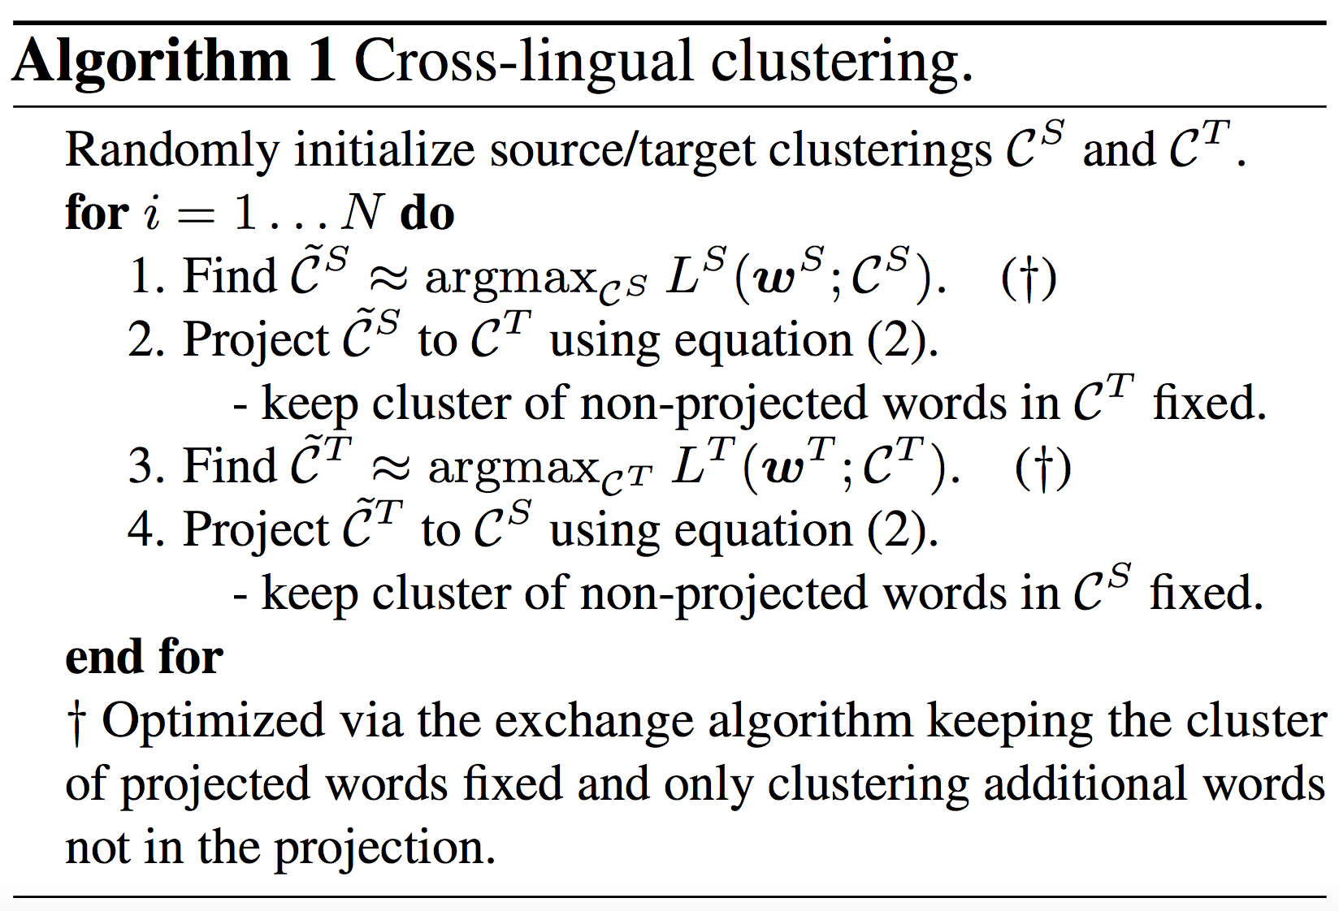
Cross-lingual Word Clusters for Direct Transfer of Linguistic Structure
Inducing Cross-lingual Word Clusters
Complex idea Algorithm:

Slide 38
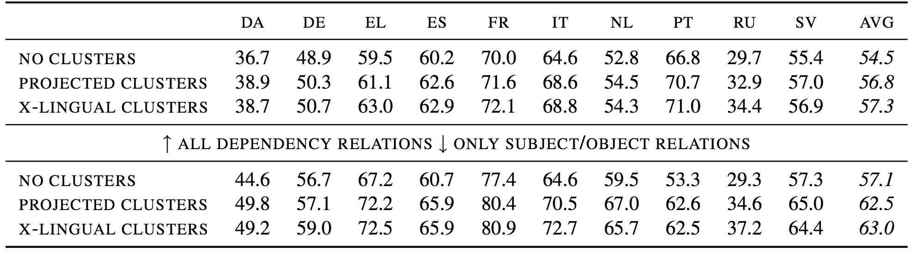
Cross-lingual Word Clusters for Direct Transfer of Linguistic Structure
Inducing Cross-lingual Word Clusters
Results measured by unlabeled attachment score (UAS)
Comparable to Projected cluster:
even simple direct parsing with Cross-lingual Word Clusters is good enough.

Slide 39
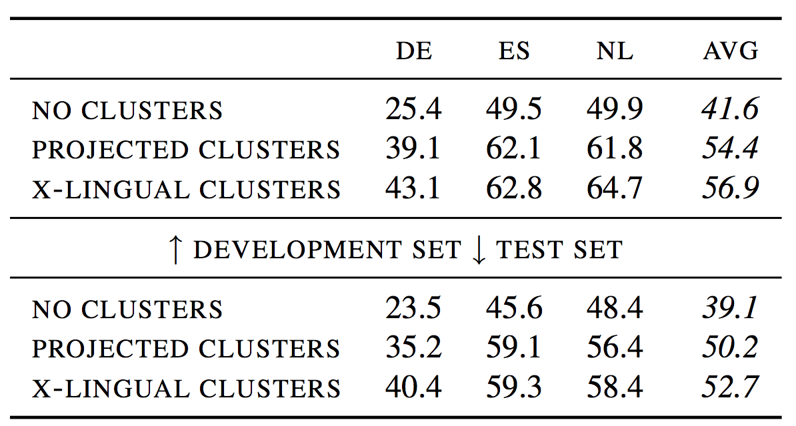
Cross-lingual Word Clusters for Direct Transfer of Linguistic Structure
Inducing Cross-lingual Word Clusters
Direct transfer NER Results measured by F1-score
Comparable to Projected cluster:
even simple direct parsing with Cross-lingual Word Clusters is good enough.

Slide 40
Cross-lingual Word Clusters for Direct Transfer of Linguistic Structure
Conclusion:
word clusters improve supervised dependency parsing
Design a cross-lingual word cluster algorithm.

Slide 41
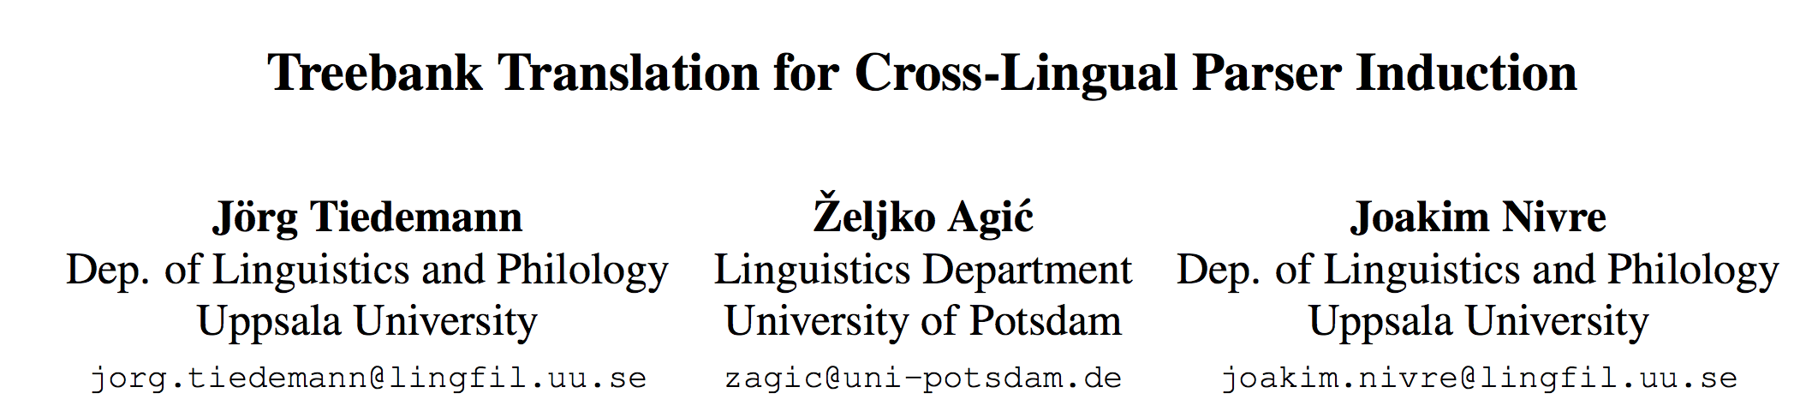
Treebank Translation for Cross-Lingual Parser Induction

Slide 42
Treebank Translation for Cross-Lingual Parser Induction
Background:
Cross-lingual learning popular for low-density languages.
Traditional approaches:
projecting annotations across parallel corpora
transferring models from multi source languages to a target language
annotation projection
+
model transfer
In this paper:
3. Using statistical machine translation (SMT) to create synthetic training data from the original source-side annotations.
Better than delexicalized transfer parsing

Slide 43
Treebank Translation for Cross-Lingual Parser Induction
Why we use SMT?
using SMT, we do not accumulate errors from two sources:
the tool (tagger or parser)
domain shift problems
SMT produce output much closer to the input than manual translations in parallel texts

Slide 44
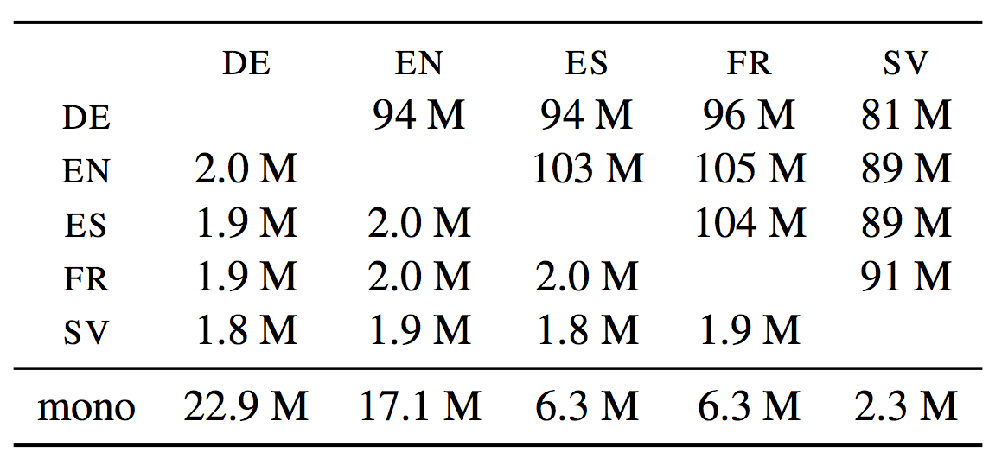
Treebank Translation for Cross-Lingual Parser Induction
Parallel data and monolingual data used for training the SMT models
Lower-left: number of sentence pairs;
Upper-right: number of tokens (source and target language together)
Bottom: number of sentences in monolingual corpora

Slide 45
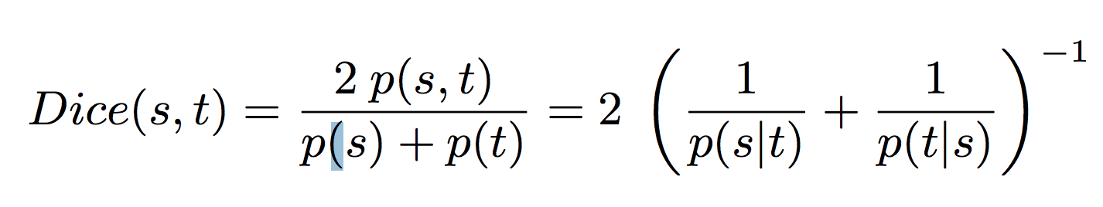
Treebank Translation for Cross-Lingual Parser Induction
three different translation approaches
1. based on a very simple word-by-word translation model (Look Up)
2. WORD-BASED MT, slightly more elaborate but still one-to-one word mappings
3. based on the entire phrase table using the standard approach to PHRASE-BASED SMT

Slide 46
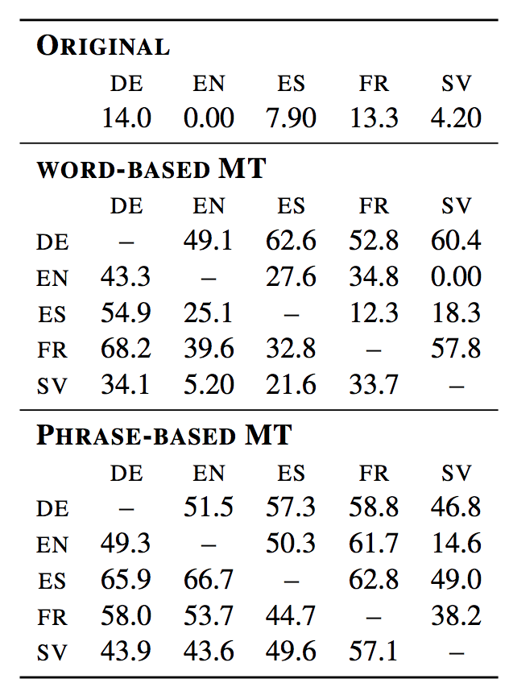
Treebank Translation for Cross-Lingual Parser Induction
Approach2:
reordering may have a strong impact on projectivity
Non-projectivity in synthetic treebanks

Slide 47
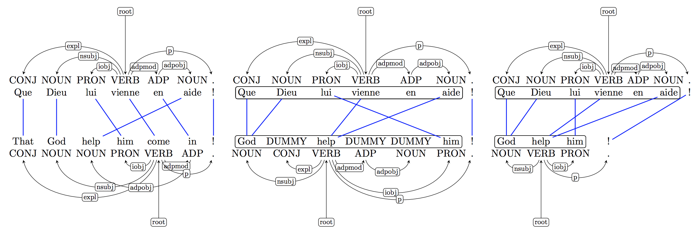
Treebank Translation for Cross-Lingual Parser Induction
Annotation transfer
Approach2:
reordering may have a strong impact on projectivity
WORD-BASED translation model
(non-proj)
PHRASE-BASED translation model (proj)
Direct Projection
our approach

Slide 48
Treebank Translation for Cross-Lingual Parser Induction
Experiments:
Baseline Results
Translated Treebanks
Delexicalized Parsers
Lexicalized Parsers

Slide 49
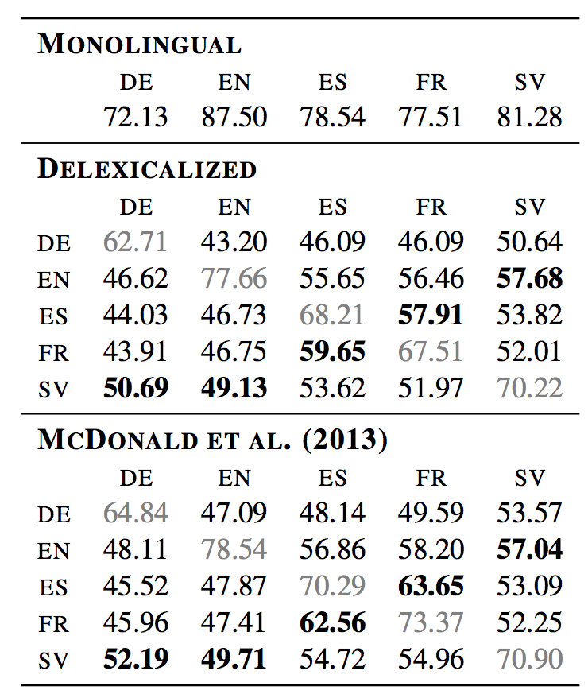
Treebank Translation for Cross-Lingual Parser Induction
Baseline Results
Baselines: (labeled attachment score (LAS))
the monolingual baseline
the delexicalized baseline

Slide 50
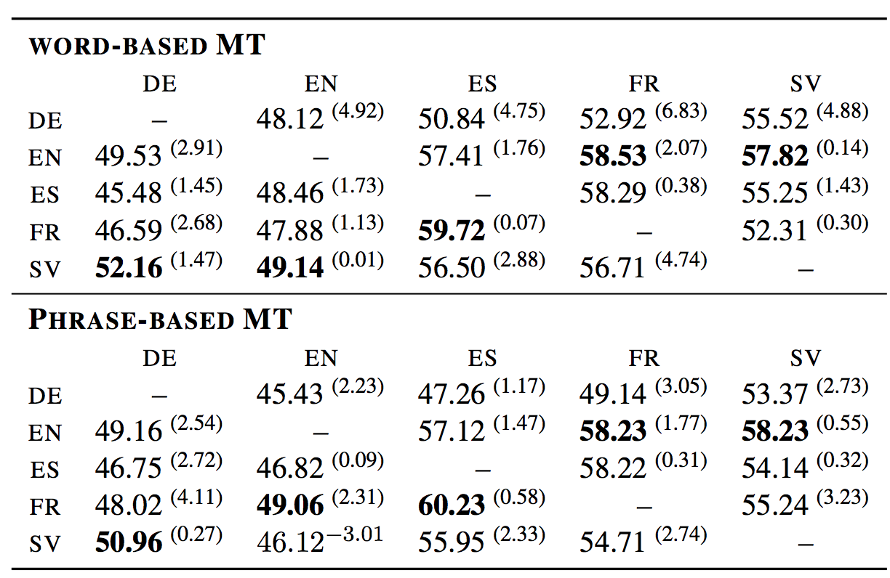
Treebank Translation for Cross-Lingual Parser Induction
Translated Treebanks (Delexicalized Parsers) :
Translated treebanks: labeled attachment score (LAS) for delexicalized parsers trained on synthetic data created by translation.
the absolute improvement over delexicalized baselines.

Slide 51
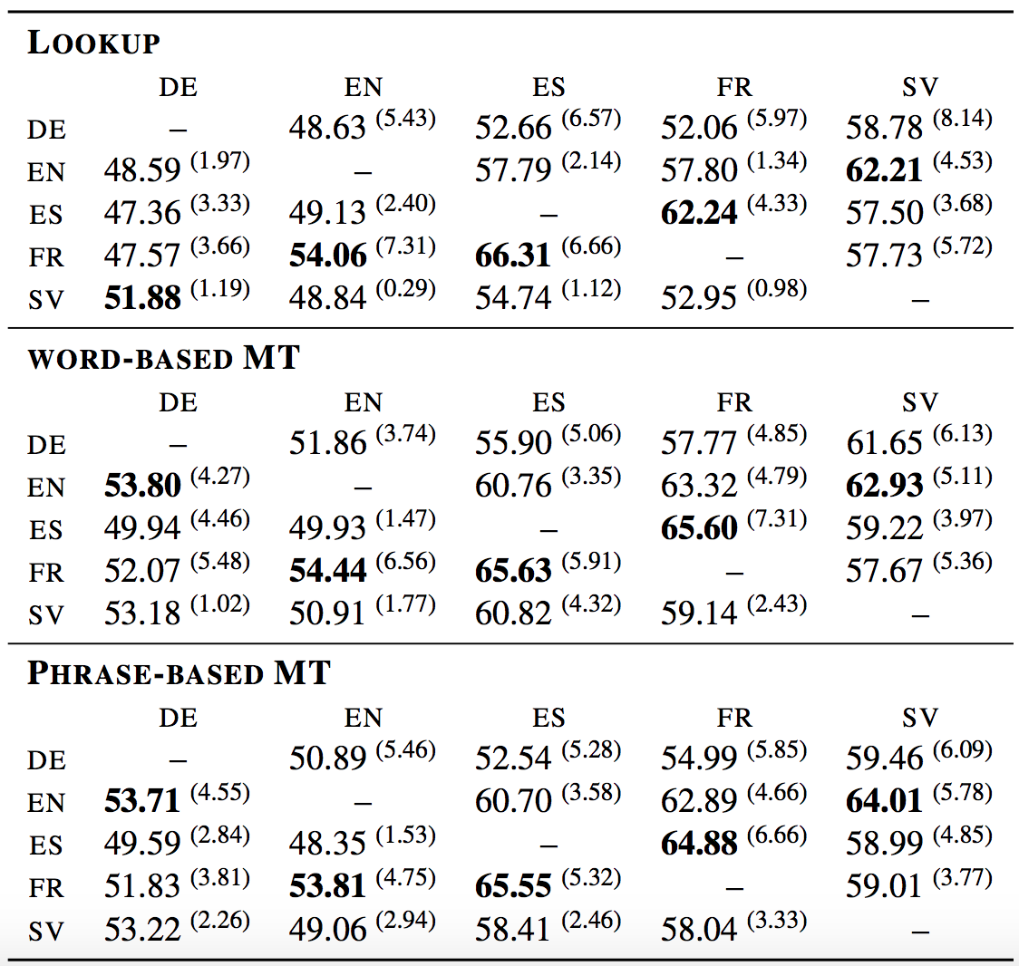
Treebank Translation for Cross-Lingual Parser Induction
Translated Treebanks (Lexicalized Parsers) :
the absolute improvements over the delexicalized models based on the same translation strategy
Conclusion:
demonstrates the ability of the training procedure to pick up valuable lexical information from the noisy translations.

Slide 52
Treebank Translation for Cross-Lingual Parser Induction
Conclusion:
Use statistical machine translation (SMT) for cross-lingual parser.
Achieve better performance.
Further Work:
studying the impact of other SMT properties
implementing more sophisticated methods for annotation projection.
using n-best lists provided by SMT models to introduce additional synthetic data using a single resource.
applying our approach to transfer parsing for closely related languages.

Slide 53
Thank you.
Questions and Suggestions

